Slide 1

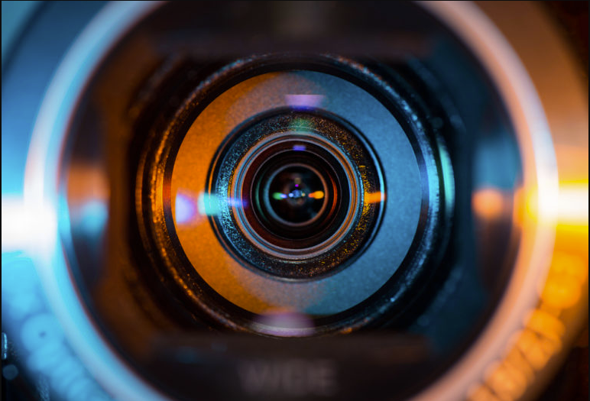
RESEARCH PROJECT Hyperspectral Image Preprocessing ~Image Registration~
Student: Buzatu Rares Tudor
Coordinator: Ion Necoara
Master: Artificial Intelligence

Slide 2

INTRODUCTION
Image Registration
Hyperspectral images
Medical imaging
03
TOPICS
01
Overview of research
02
What is it?
General steps of algorithms
What are they?
How are they used?
04
CT scans
STATE OF THE ART
05
Examples
Chosen method
06
PROGRESS
07
CONCLUSIONS
08
FUTURE WORK

Slide 3

INTRODUCTION
01
Overview of research

Slide 4
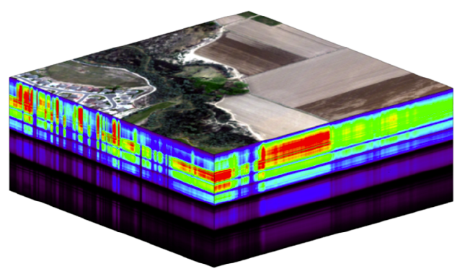



PROJECT AND PARTNERS
Efficient Learning and Optimization Tools for Hyperspectral Imaging Systems (ELO-Hyp)
Norwegian University of Science and Technology (NTNU)
Coltea Hospital
University Politehnica Bucharest
University of Bucharest
Hyperspectral images
Geographic images: algae
Drone image videos
Algae Identification
Medical Images: CT scans
CT image registration
Optimization techniques
Machine learning
Vision
Machine learning
Vision
*https://www.neonscience.org/resources/learning-hub/tutorials/hsi-hdf5-r
**https://stock.adobe.com/search?k=ct+scan+icon
***https://logopond.com/fraGile/showcase/detail/285847
****https://www.kindpng.com/imgv/iRbhRow_artificial-intelligence-logo-png-transparent-png/

Slide 5
MY ROLE AND CONTRIBUTION
Aerial algae images
Ct scans images
Take algae and CT scans images
Particularize registration methods
Improve existing methods
Algorithms
Architectures
Image registration

Slide 6
IMAGE REGISTRATION
02
What is it?

Slide 7
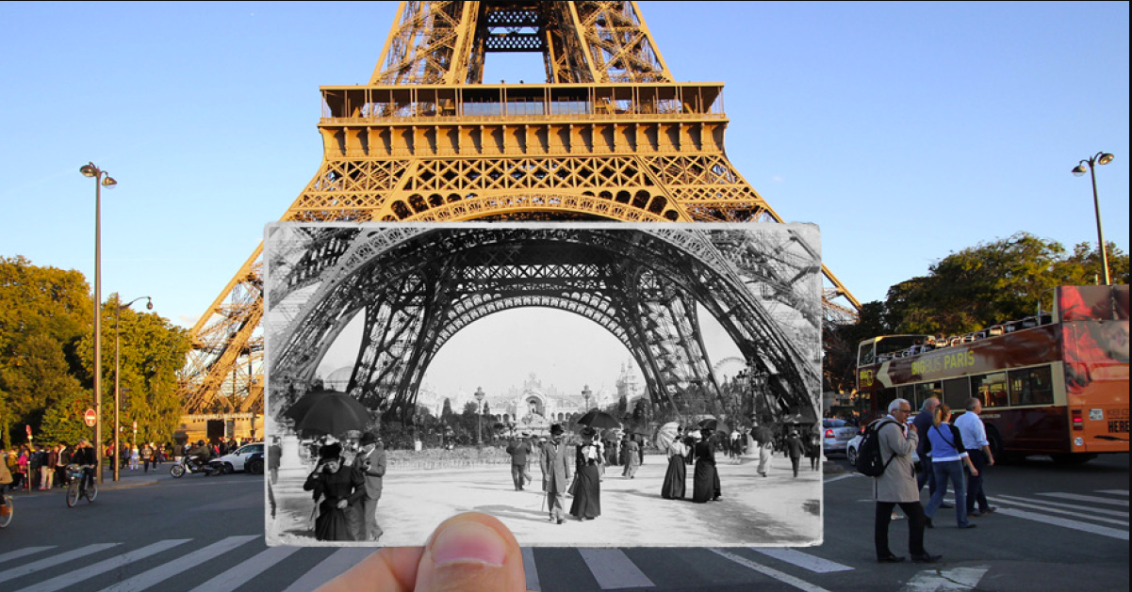
ALLIGNING IMAGES
*https://www.boredpanda.com/combining-old-new-photos-historical-photography-julien-knez-paris/?utm_source=google&utm_medium=organic&utm_campaign=organic

Slide 8
IMAGE REGISTRATION
02
General steps

Slide 9
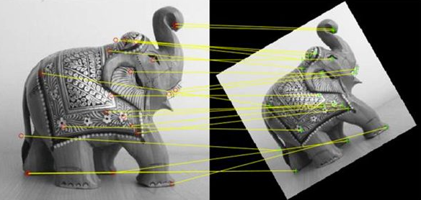
REGISTRATION STEPS
01
02
03
04
Find keypoints
Apply descriptors
Match features
Apply transformation
*https://www.mathworks.com/discovery/image-registration.html

Slide 10
HYPERSPECTRAL IMAGES
03
What are they?

Slide 11
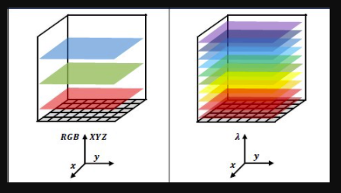
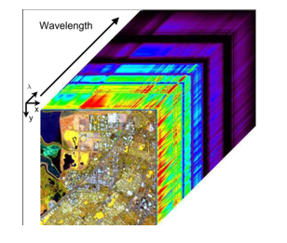
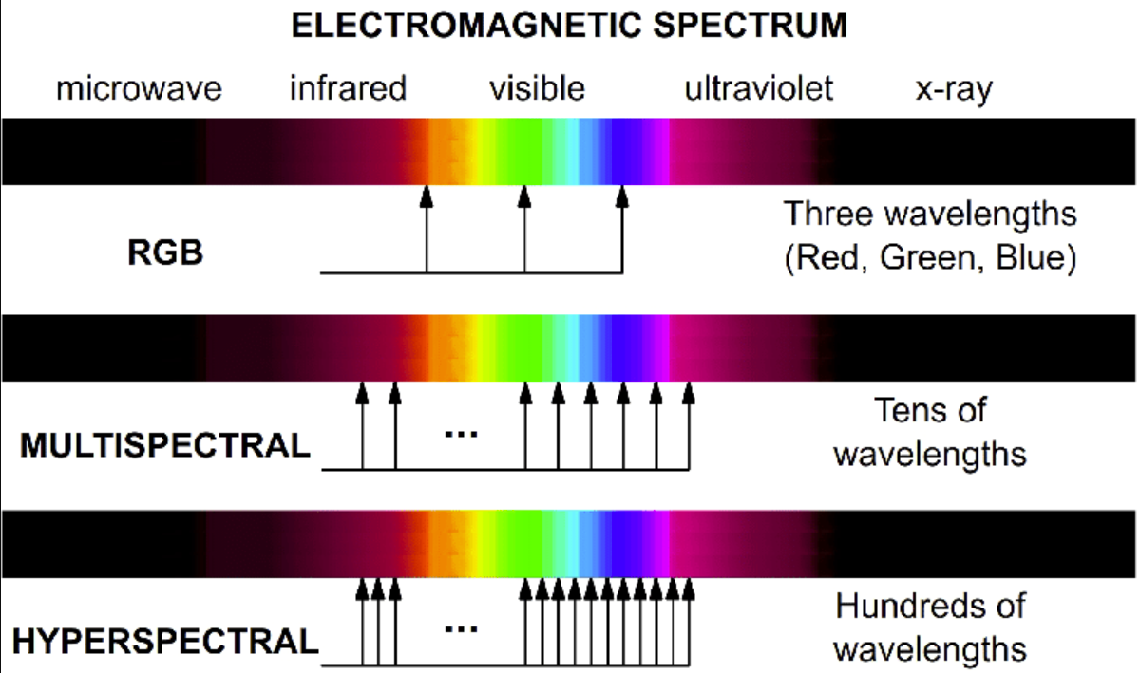
HYPERSPECTRAL IMAGES
*https://towardsdatascience.com/what-are-hyper-spectral-images-a5de5d9fa91
**E. Christophe & C. Mailhes & P. Duhamel, “Hyperspectral image compression: Adapting SPIHT and EZW to anisotropic 3-D wavelet coding”, IEEE, 2009
***H. Grahn; P. Geladi, “Techniques and Applications of Hyperspectral Image Analysis. “, John Wiley & Sons. ISBN 978-0-470-01087-7., 27 September 2007

Slide 12
HYPERSPECTRAL IMAGES
03
How are they used?

Slide 13
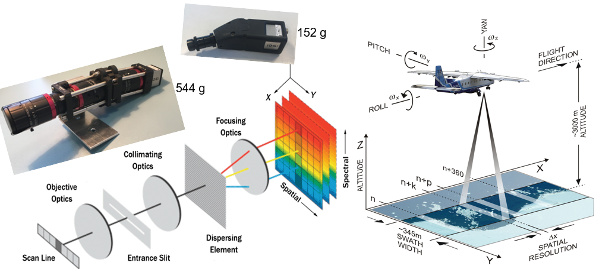
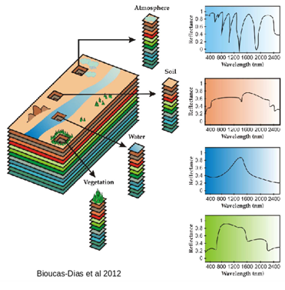
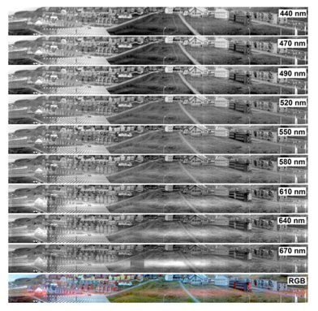
HYPERSPECTRAL IMAGES
*F. Sigernes, M. Surjäsuo, R. Storvold, J. Fortuna, M. E. Grøtte, T. A. Johansen, “Do it yourself hyperspectral imager for handheld to airborne operations”, Optics Express, 2018

Slide 14
MEDICAL IMAGING
03
CT Scans

Slide 15
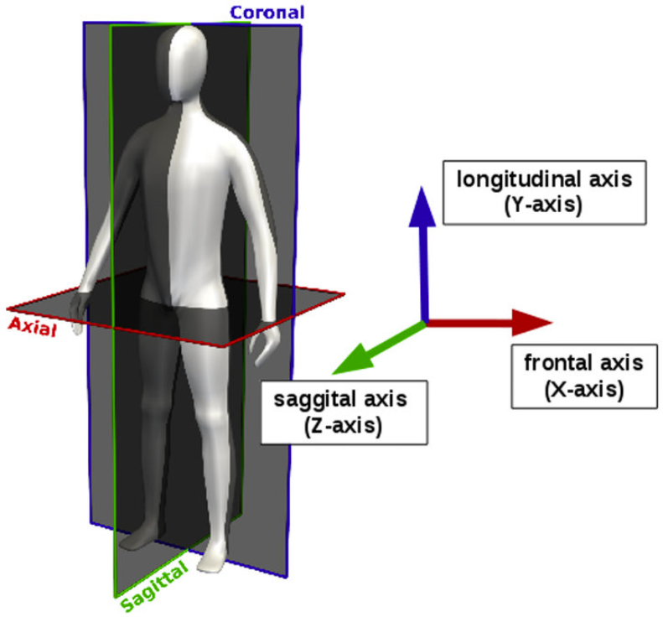
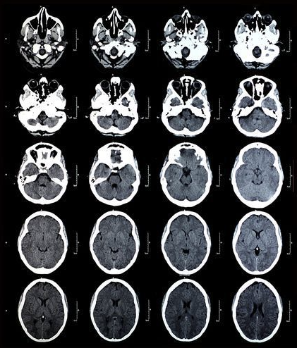
CT SCAN
4 series (Multi modal registration)
150 photos (Multi-view registration)
1 CT scan = 4 series of photos
1 series ~= 150 photos (slices)
Contrast substance
*E. Heim, “Large-scale medical image annotation with quality-controlled crowdsourcing”, URN: urn:nbn:de:bsz:16-heidok-246418 , 2018
**https://www.jimdodsonlaw.com/faqs/ct-or-cat-scans-can-be-used-to-diagnose-brain-injuries.cfm

Slide 16
STATE OF THE ART
04
Examples

Slide 17
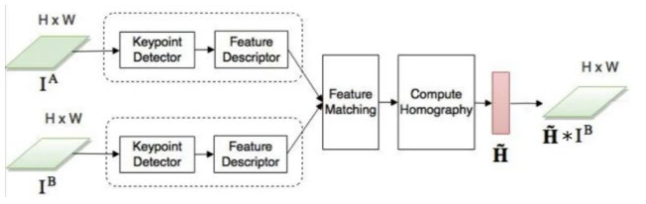
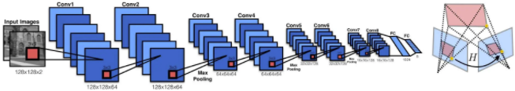
TRADITIONAL VS. DEEP LEARNING
Traditional Approaches
Deep Learning
Easy to implement
P.O.: Trustful
Basic transformation
Harder to implement
P.O.: Not so trustful
Advanced transformations
P.O. = Public Opinion
*E. Kamoun, J. Joslove, "Image Registration: From SIFT to Deep Learning", https://www.sicara.ai/blog/2019-07-16-image-registration-deep-learning, 2019
**D. DeTone, T. Malisiewicz, A. Rabinovich, “Deep Image Homography Estimation”, arXiv:1606.03798, 2016

Slide 18
STATE OF THE ART
04
Chosen Method

Slide 19
BEST OF BOTH WORLDS
Traditional Approaches
Deep Learning
Trustful
Complex, powerful
Chosen method

Slide 20
CHOSEN METHOD
Characteristics:
Extracting features: VGG16 – pooling layers
Feature matching: polar coordinates cost + linear assignment + G.M.M.
Transformation: E.M. + G.R.B.
Advantages:
Extract complex features
Solid matching function
Transformation without neural nets

Slide 21
RESULTS & EXPERIENCE
06

Slide 22
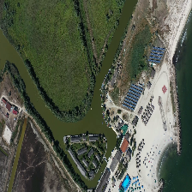
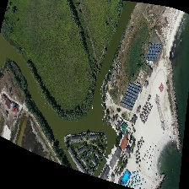
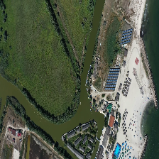
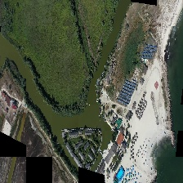
RESULTS AND EXPERIENCE
Every 2 weeks meetings with all partners
Hospital visit for understanding CT
Implemented code in Python
Found medical dataset
A) Reference B) Registered C) Test D) Checkered
*M. Leordeanu, Computer Vision slides, Course 8: Alignment and matching

Slide 23
CONCLUSIONS
07

Slide 24
CONCLUSIONS
Accommodation with the topics
Review State-of-the-Art
Found possible solution
Acquired medical data

Slide 25
FUTURE WORK
08

Slide 26
FUTURE WORK
Test medical datasets
Obtain algae dataset
Change dataset for training
Change network architecture
Tweak algorithm hyperparameters

Slide 27
THANK YOU

